Slide 1


Spam Email Classification
Submitted by:
Nidhi Singh
SME:Shwetank Mishra

Slide 2
TABLE OF CONTENTS
INTRODUCTION
Business Problem Framing
CONCEPTUAL BACKGROUND OF THE DOMAIN PROBLEM
Motivation for the Problem undertaken
Exploratory Data Analysis (EDA)
Data Visualization
Model/s Development and Evaluation
Hyperparameter tuning using GridSearchCV
Conclusion

Slide 3
Business Problem Framing
You were recently hired in a Start-up Company and was asked to build a system to identify spam emails. We will explore and understand the process of classifying Emails as Spam or Not Spam by build Machine Learning and NPL model to detect the HAM and SPAM mails. The model will detect the unsolicited and unwanted emails and thus we can prevent them from creeping into user’s inbox and therefore, increase the user Experience.

Slide 4
CONCEPTUAL BACKGROUND OF THE DOMAIN PROBLEM
As we know how a machine translates language, or how voice assistants respond to questions, or how mail gets automatically classified into spam or not spam, all these tasks are done through Natural Language Processing (NLP), which processes text into useful insights that can be applied to future data. In the field of artificial intelligence, NLP is one of the most complex areas of research due to the fact that text data is contextual. It needs modification to make it machine-interpretable and requires multiple stages of processing for feature extraction.
Classification problems can be broadly split into two categories: binary classification problems, and multi-class classification problems. Binary classification means there are only two possible label classes, e.g. a patient’s condition is cancerous or it isn’t, or a financial transaction is fraudulent or it is not. Multi-class classification refers to cases where there are more than two label classes. An example of this is classifying the sentiment of a movie review into positive, negative, or neutral.

Slide 5
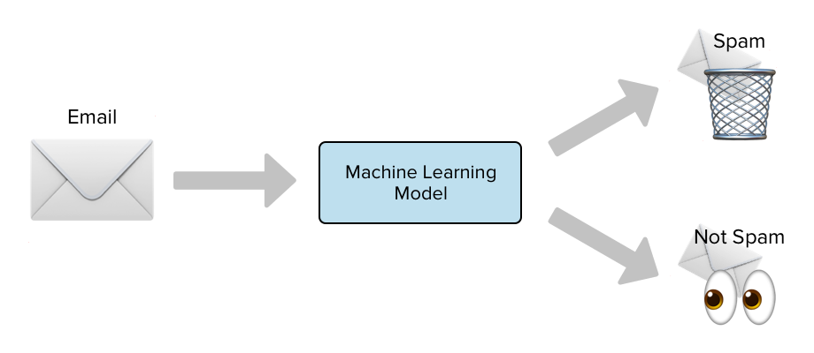
There are many types of NLP problems, and one of the most common types is the classification of strings. Examples of this include the classification of movies/news articles into different genres and the automated classification of emails into a spam or not spam. We shall be looking into this last example in more detail for this project.

Slide 6
MOTIVATION FOR THE PROBLEM UNDERTAKEN
Motivation for this project has been undertaken because it is a project which is assigned to me during my internship at Flip Robo Technologies. This project will help Start-up companies to detect and filter the SPAM mails in their Email inbox and therefore, increase the user experience and save their server from unwanted mails, phishing mails or other viruses.

Slide 7
Exploratory Data Analysis (EDA)
Importing necessary libraries and loading dataset as a data frame.
Checked some statistical information like shape, number of unique values present, info, null values, value counts, duplicated values etc.
Checked for null values and did not find any null values. And removed Id.
Done feature engineering and created new columns viz label: which contain both good and bad comments which is the sum of all the labels, comment_length: which contains the length of comment text.
Visualized each feature using seaborn and matplotlib libraries by plotting categorical plots like pie plot, count plot, distribution plot and wordcloud for each label.

Slide 8
Done text pre-processing techniques like Removing Punctuations and other special characters, Splitting the comments into individual words, Removing Stop Words, Stemming and Lemmatization.
Then created new column as clean_length after cleaning the data. All these steps were done on both train and test datasets. Checked correlation using heatmap.
After getting a cleaned data used TF-IDF vectorizer. It’ll help to transform the text data to feature vector which can be used as input in our modelling. It is a common algorithm to transform text into numbers. It measures the originality of a word by comparing the frequency of appearance of a word in a document with the number of documents the words appear in.

Slide 9
Data Visualization
I used pandas profiling to get the over viewed visualization on the pre-processed data.
Pandas is an open-source Python module with which we can do an exploratory data analysis to get detailed description of the features and it helps in visualizing and understanding the distribution of each variable.
I have used wordcloud to get the sense of loud words in the labels.

Slide 10
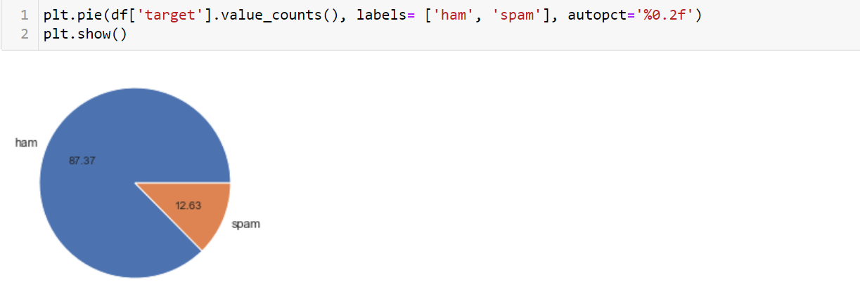

Slide 11
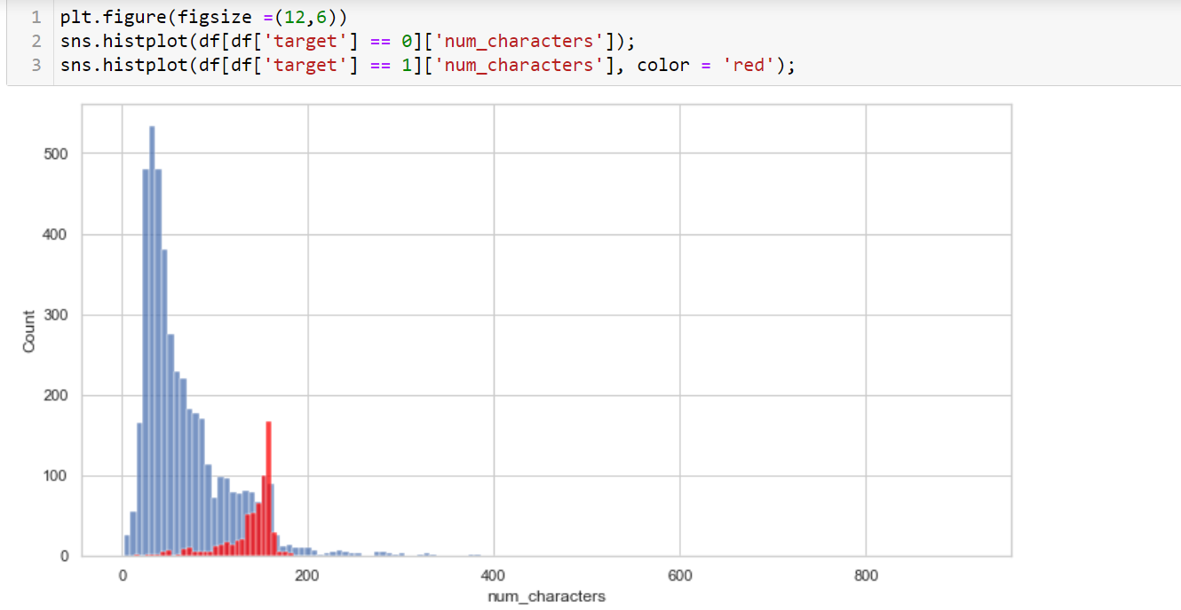

Slide 12
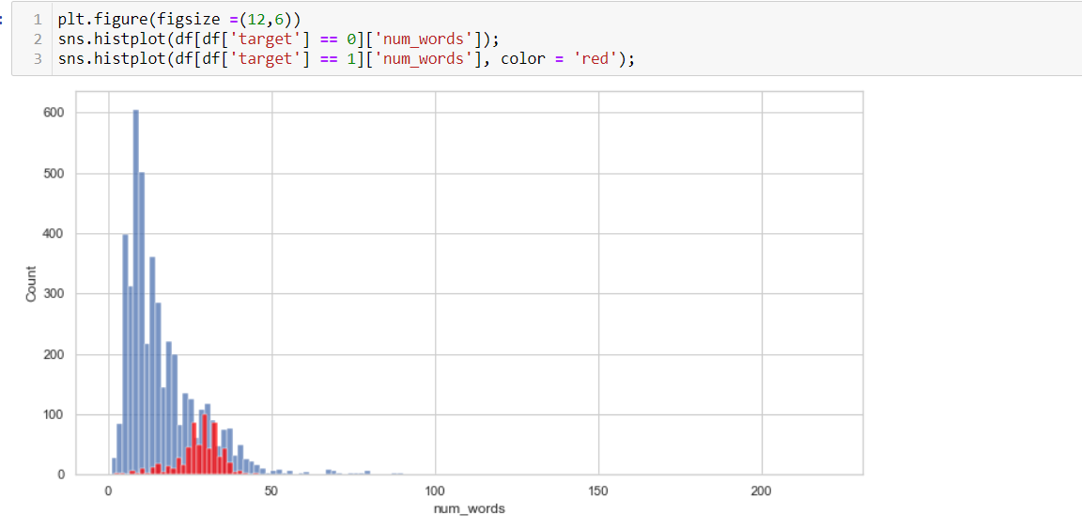

Slide 13
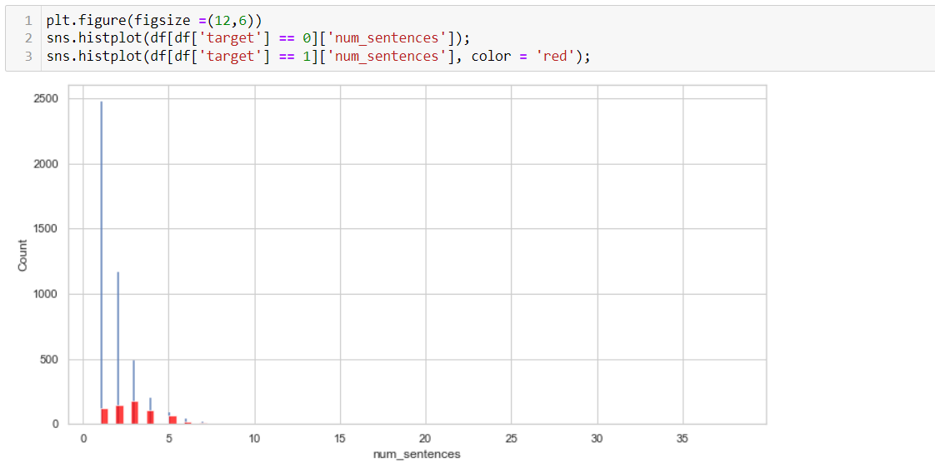

Slide 14
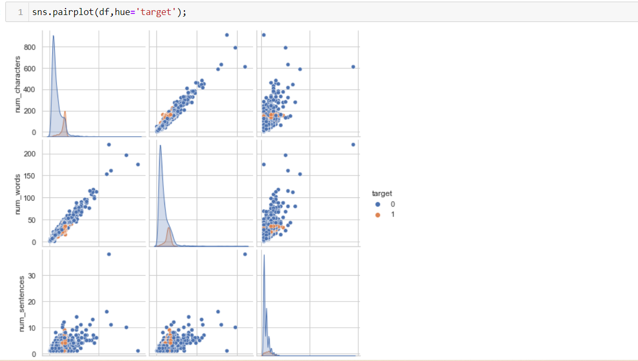

Slide 15
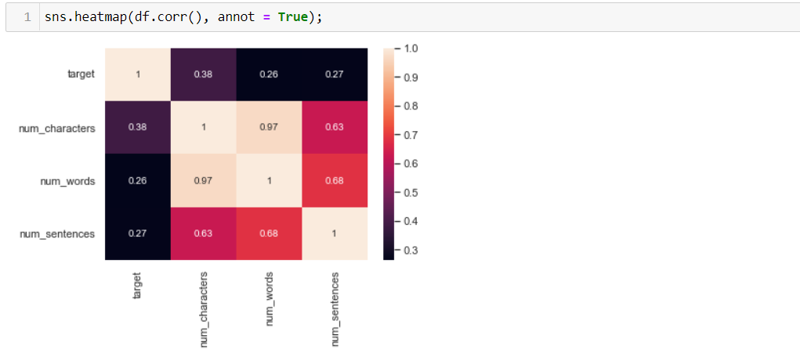

Slide 16
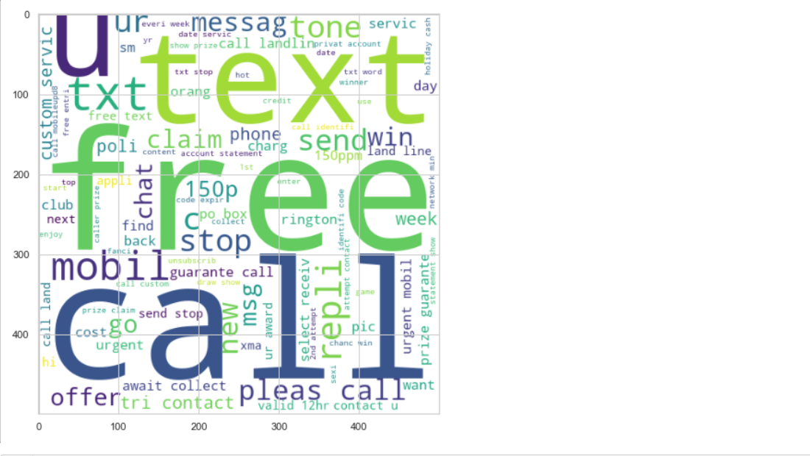

Slide 17
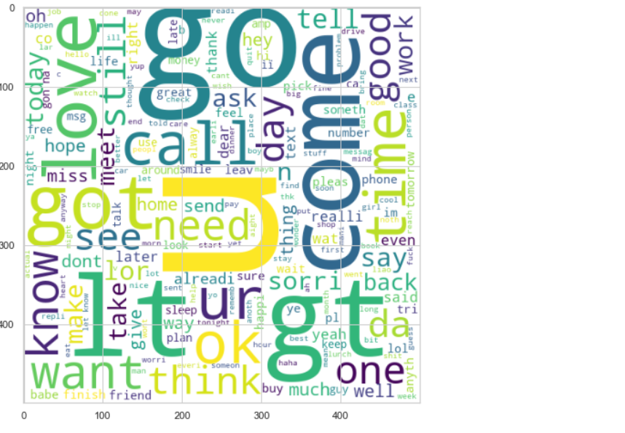

Slide 18
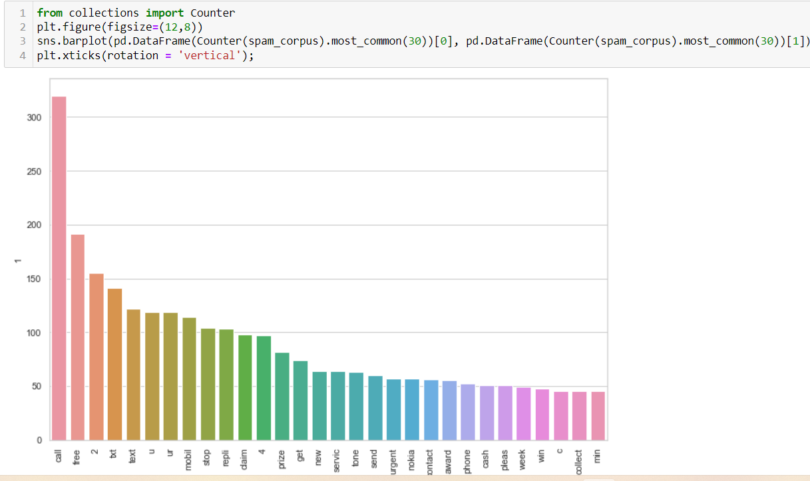

Slide 19
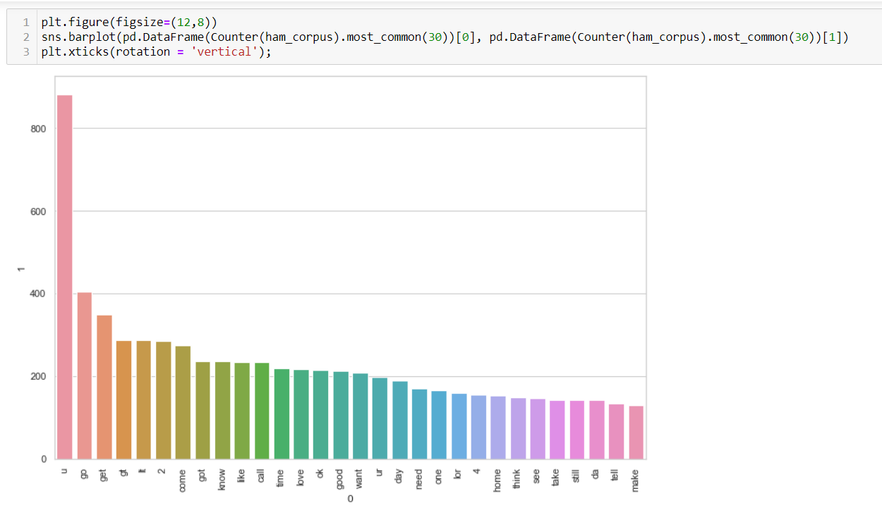

Slide 20
Model/s Development and Evaluation
I have used 13 classification algorithms. First, I have created 13 different classification algorithms and are appended in the variable models. Then, ran a for loop which contained the accuracy of the models along with different evaluation metrics.

Slide 21
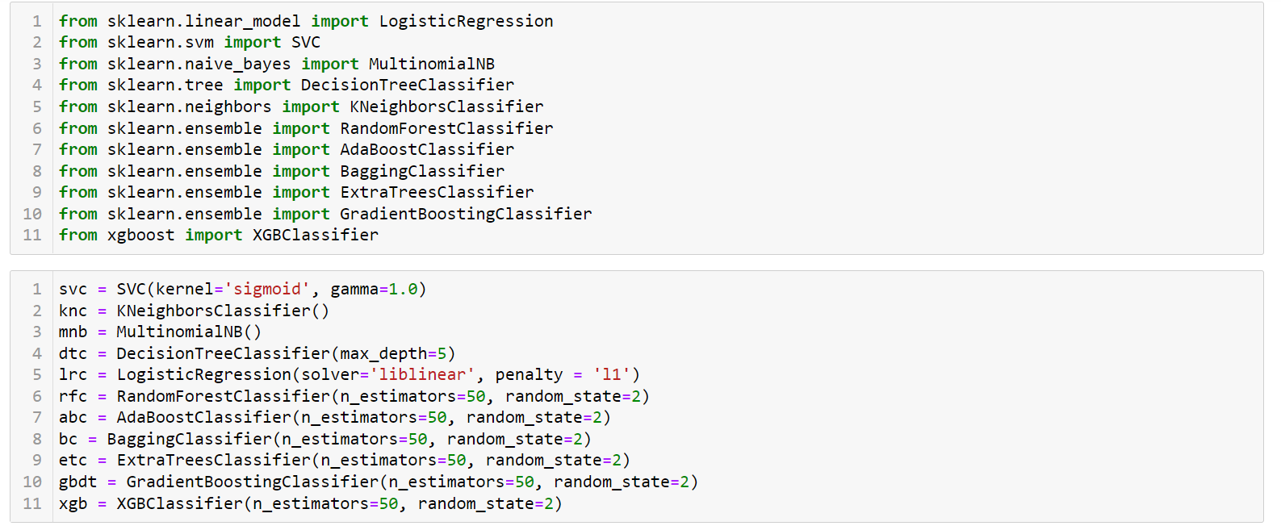

Slide 22
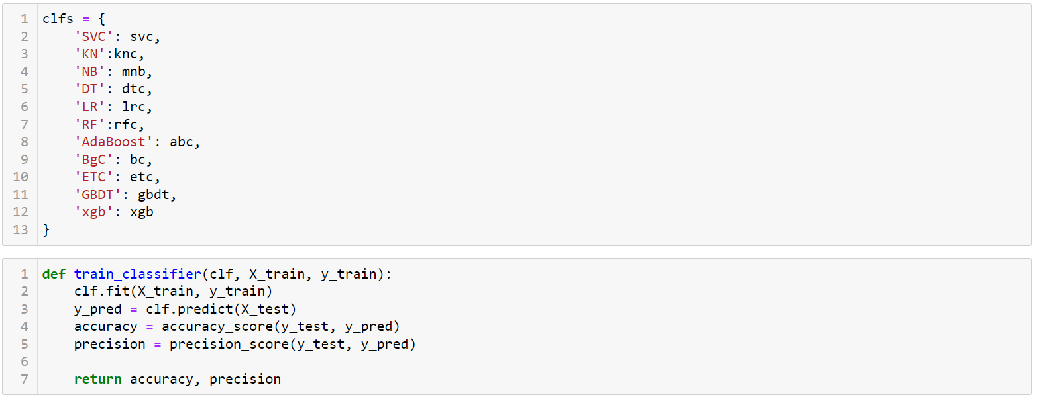
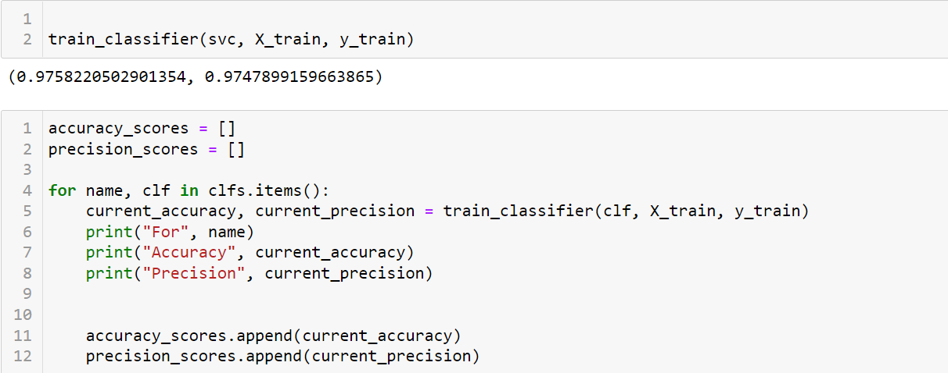

Slide 23
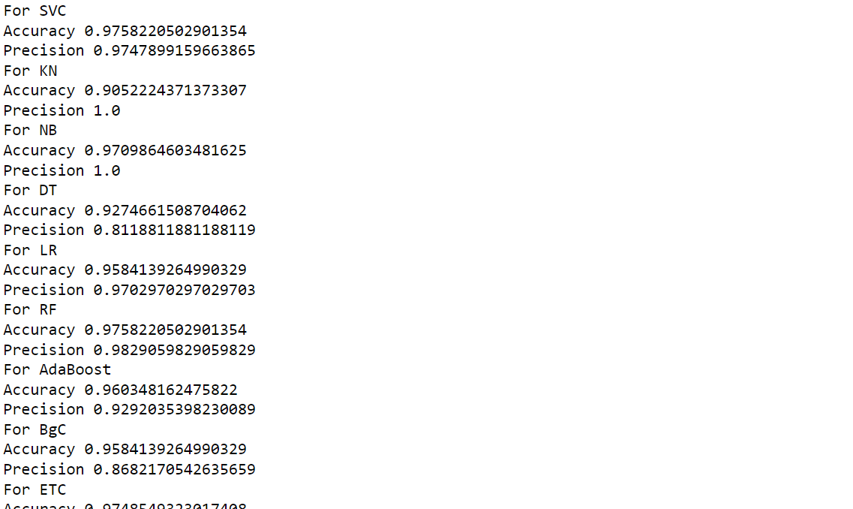
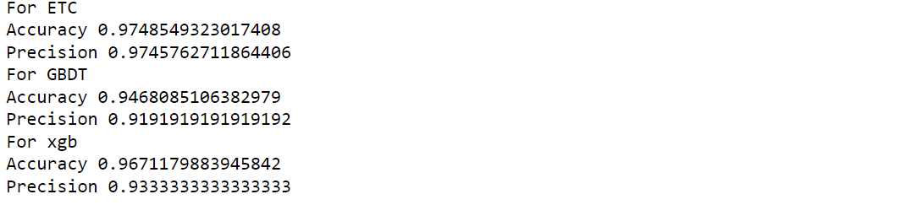

Slide 24
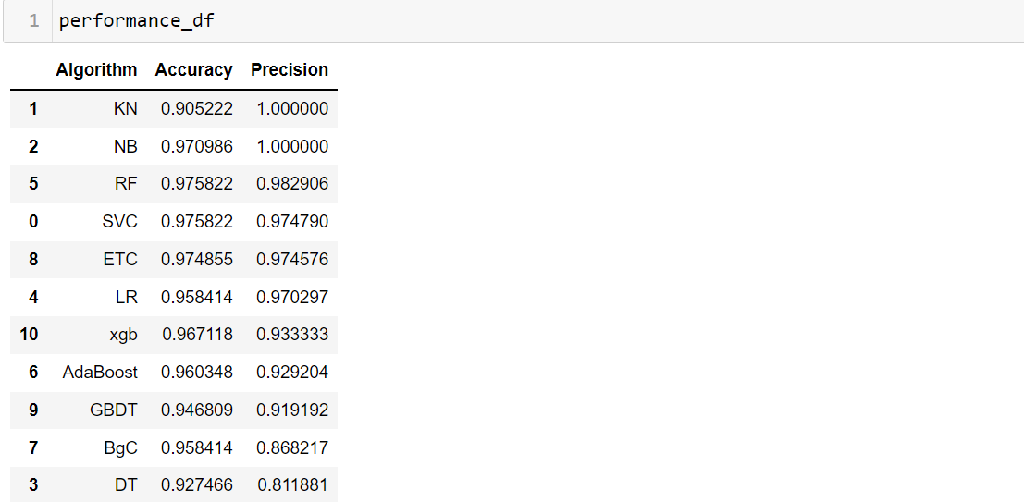

Slide 25
Conclusion
From the whole evaluation we found out that the spam emails can be classified and can be stopped doing harm to the users.
I found visualisation a very useful technique to infer insights from dataset.
We are able to classify the emails as spam or non-spam. With high number of emails lots if people using the system it will be difficult to handle all possible mails as our project deals with only limited amount of corpus

